Slide 1



Bingo billionaire
F28WP
featuring – anna, emily, euan, evelyn, yoana

Slide 2
aims
The aims of this stake money website are simple:
As a group, we want to create a fun, but also security assured experience. To achieve this, the user will need to create an account with company that will verify age and a bank card so they may participate in the game.

Slide 3
scope
Additional features we'd like to set is a pre-approved spending cap on account creation.
The website itself will be a bingo-based game where the user will tick off numbers as they appear on the game. If they fill a sheet before the timer expires then they win!

Slide 4


Functional vs Non-Functional requirements
Functional
NON-Functional
Users must be able to create an account and can log in, while also being able to delete the account.
The website must be able to verify user’s age and if the user is under 18, then an error message will show up.
Users must have valid bank details.
Users must deposit a set amount of money to play.
The game should be easy to understand for users and be simple enough to play.
Prizes will only be money based, and the more the users plays the more the ‘money increaser’ will increase.
Users can set up an account limit, if they wish.

Slide 5
Functional vs Non-Functional requirements
Functional
NON-Functional
The website must store the user’s details (e.g. username, name, password, email, address, date of birth) into a database.
The website must have a leaderboard on where users can always see who is the no. 1 (and 2nd, 3rd etc.) at the game.
The website must have a streak system in place, so users will feel more willing to come back to the website.
The website should be easy to navigate for users.
The website should be compatible with most browsers and should work properly on both mobile and desktop devices.
The website should be engaging for the user, to keep on playing (could be with ads or promotional offers).

Slide 6
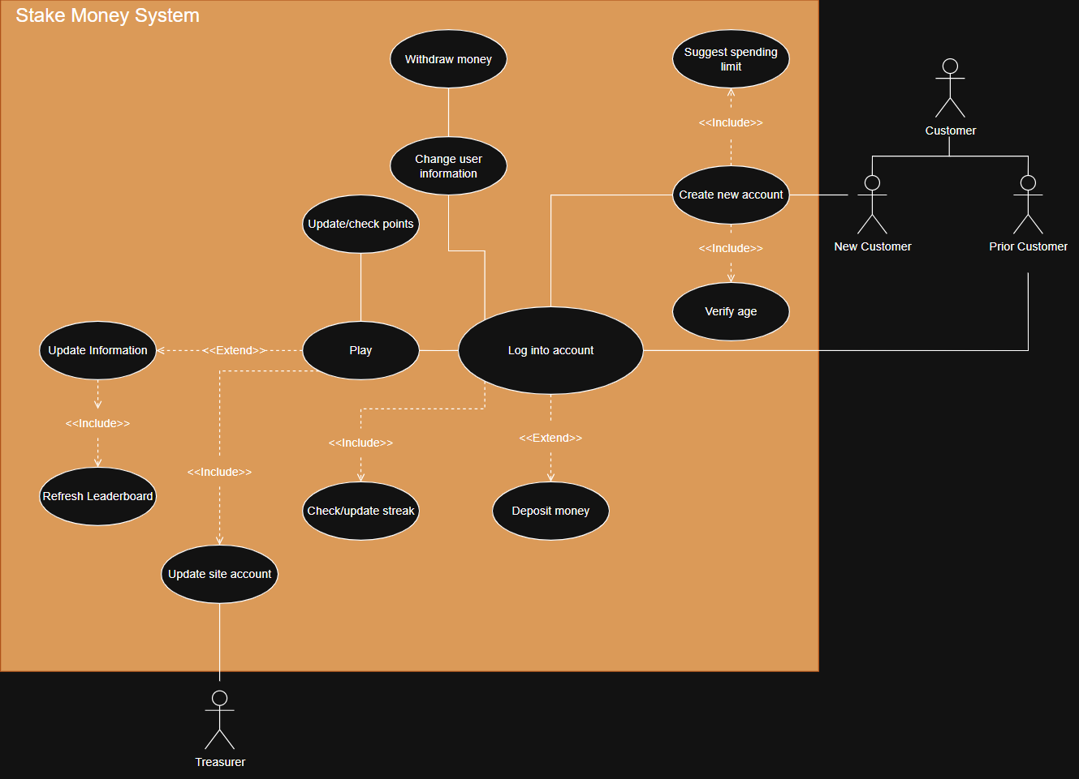
Use case diagram

Slide 7
Tools and Techniques
VScode
Notepad++
html
for implementing the code
for implementing the code another way
for overall structure of the website
css
javascript
j-query
for overall design of the website
for adding interactivity into the website
for document manipulation

Slide 8
Tools and Techniques
Json
Mysql
PowerPoint
for data transfer
for data storage
for designing the proposal of the website
excel
word
for organising key dates and showing the timeline of the project
for planning and adding quick notes

Slide 9

Project plan
who is doing what, and what is being done by who…
Anna
Emily | Design, plan presentation
Euan | Design, plan presentation
Evelyn | Design, plan presentation, CSS/HTML
Yoana | Design, plan presentation

Slide 10
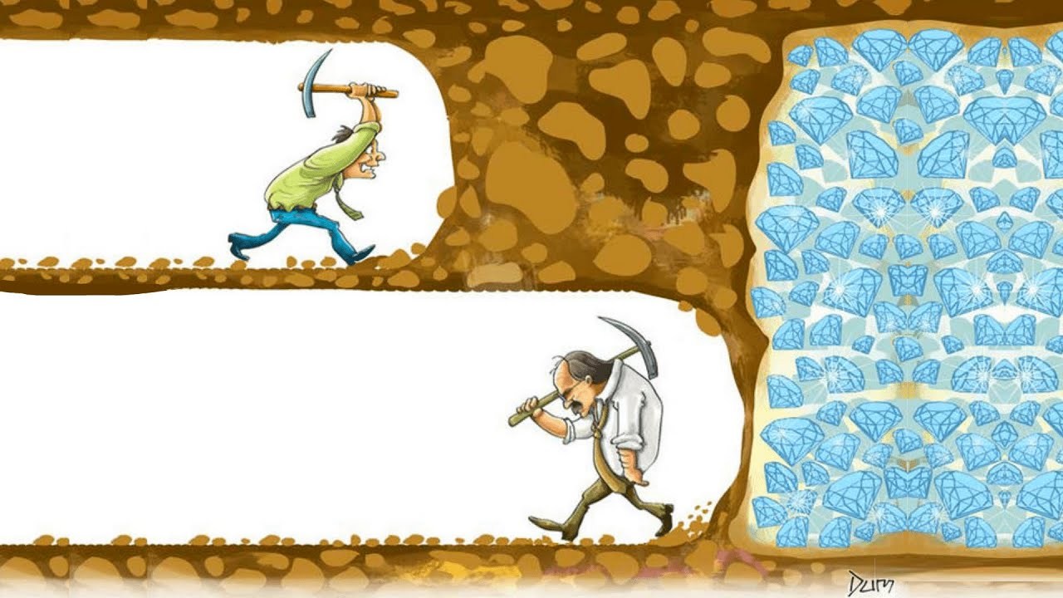



“A Captain sinks with his ship. 99% of gamblers quit before the big win (its true).” – Yoana B

Slide 11

Thanks!
DO YOU HAVE ANY QUESTIONS?

